Slide 1
Solidification of Weld Metal II
Lecture 11

Slide 2
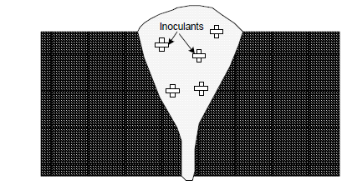
Common Methods of Grain Refinement-Inoculation
-Adding alloying elements (act as nucleants) in weld pool to increase the heterogeneous nucleation at nucleation stage . These elements Increased number of nucleants in the weld metal results in refinement of the grains in the weld.
-For aluminium, titanium and boron based compound as such TiB2, TiC, Al-Ti-B, Al-Zr are commonly used as grin refiner. For steel, Ti, V and Al are commonly used grain refiners.

Slide 3
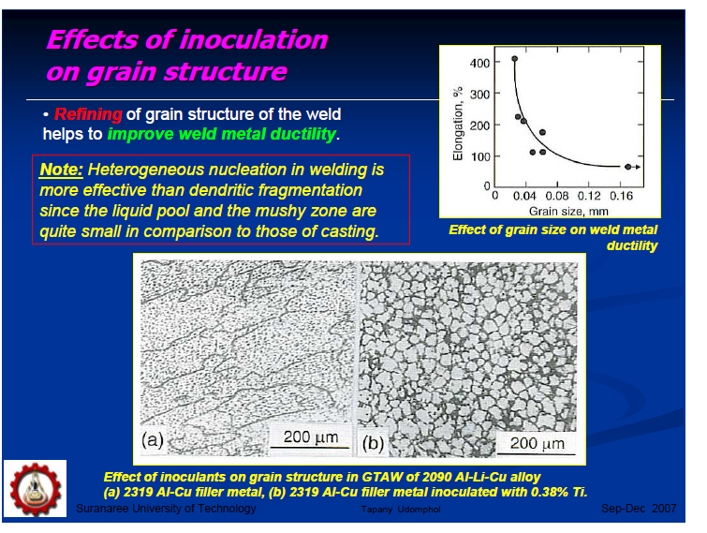
Common Methods of Grain Refinement-Inoculation

Slide 4
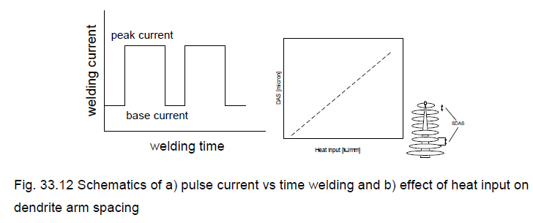
Common methods of grain refinement-Arc pulsation
-MIG and TIG processes sometime use (Pulse current),which can supply varying current called base current and peak current (Fig. 33.13).
-Pulse current supplies least amount of the heat to the weld; of the weld metal which in turn results rapid cooling and thus finer grain structure than the conventional welding i.e. without arc pulsation(Fig. 33.12).

Slide 5
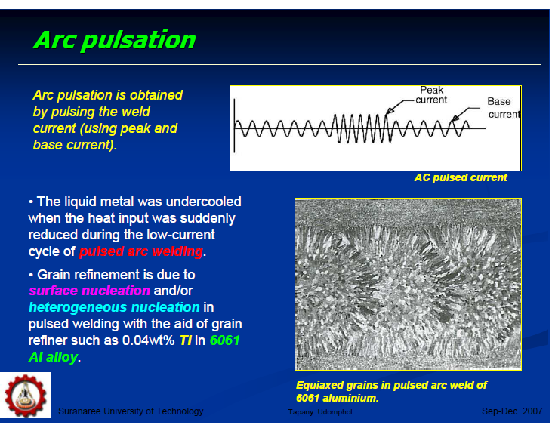
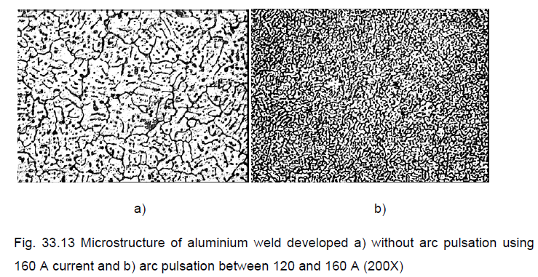
Common methods of grain refinement-Arc pulsation
With out
With Pulsing

Slide 6
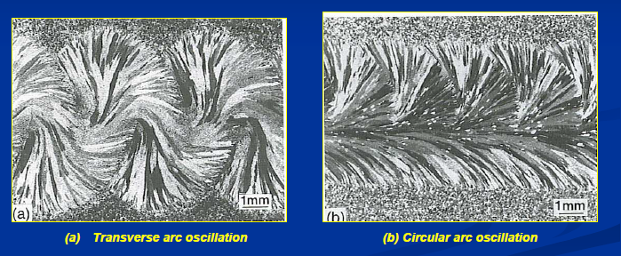
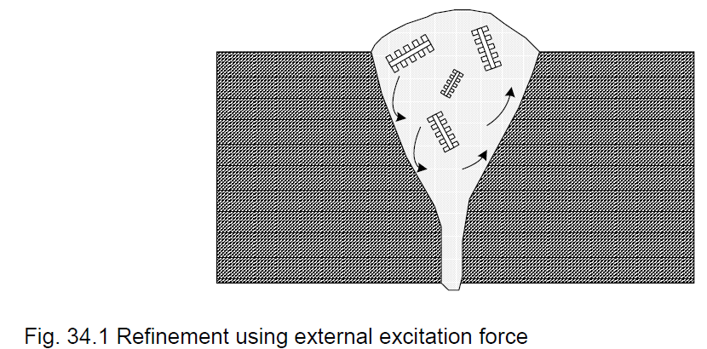
Common Methods of Grain Refinement-
Mechanical Vibrations and Electro-Magnetic Force
-It is an external excitation force causes forced flow and turbulence in the viscous semi-solid weld metal which in turn can result in
a) fracture of partially melted grains of the base metal,
b) fragmentation of solidifying dendrites and
c) improved distribution of chemical composition and
nucleants
-

Slide 7
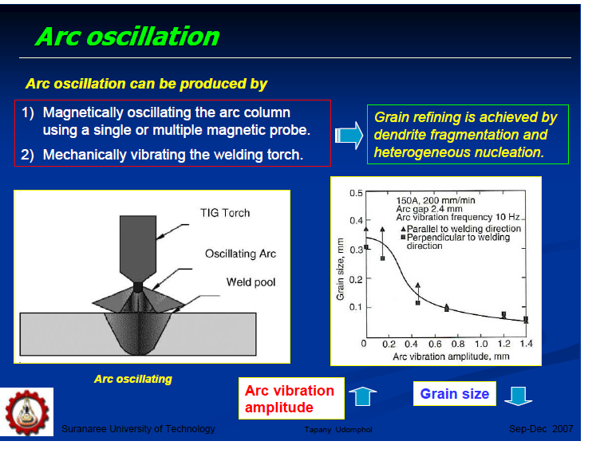
Common Methods of Grain Refinement-
Mechanical Vibrations and Electro-Magnetic Force

Slide 8
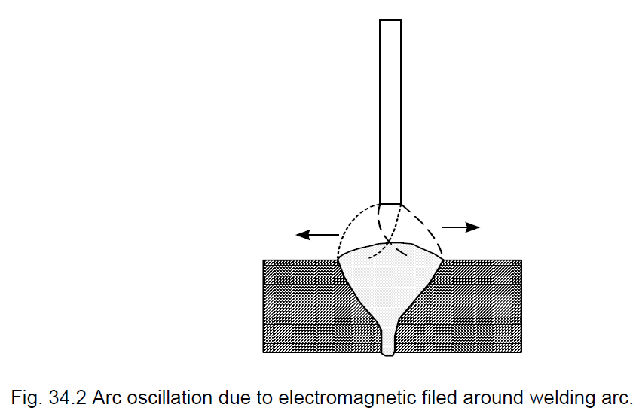
Common Methods of Grain Refinement- Magnetic Arc Oscillation
-Arc composed of charged particles can be deflected using magnetic field. Arc oscillation affects the weld pool in two ways a) reduction in the size of weld pool and b) alternate heating and cooling of weld (similar to that of arc pulsation) as shown in Fig. (34.2).

Slide 9
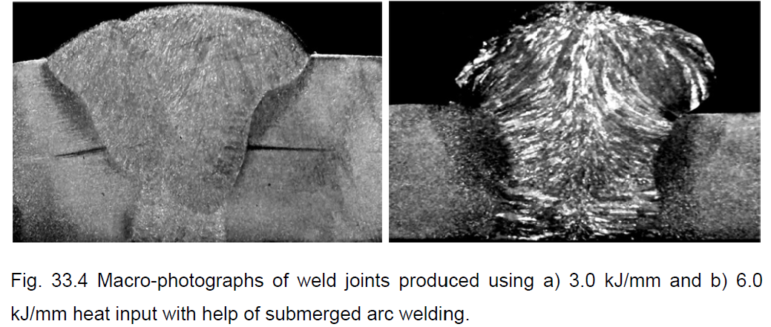
Common Methods of Grain Refinement-Welding Parameter
-Increase in welding speed for a given welding current and voltage results in reduced heat input.
High heat input lowers the cooling rate. Low cooling rate results increased solidification time (Fig. 34.3).

Slide 10
Solidification Rate
-The solidification of weld metal takes place in three stages: a) reduction in temperature of liquid metal, b) liquid to solid state transformation and c) finally reduction in temperature of solid metal up to room temperature.
-Solidification time is the time interval between start to end of solidification depends on the cooling rate.
-Solidification time affects the structure, properties and response to the heat treatment of weld metal. It can be calculated using following equation:
-Above equation indicates that solidification time is the function of net heat input (Q), initial plate temp.(to), latent heat of fusion (L), thermal conductivity (k), volumetric specific heat (ᵨ c ) and melting point (tm).

Slide 11
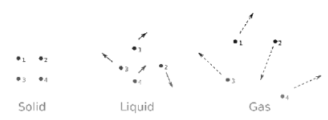
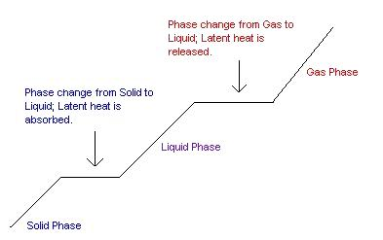
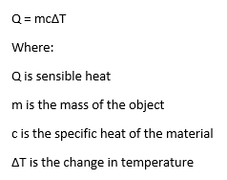
Heating Curve for a Pure Metal
Ql = M * Delta H
Delta H=H3-H2
2
3
Qs = M * C * Delta T
Delta T=T2-T1
1

Slide 12
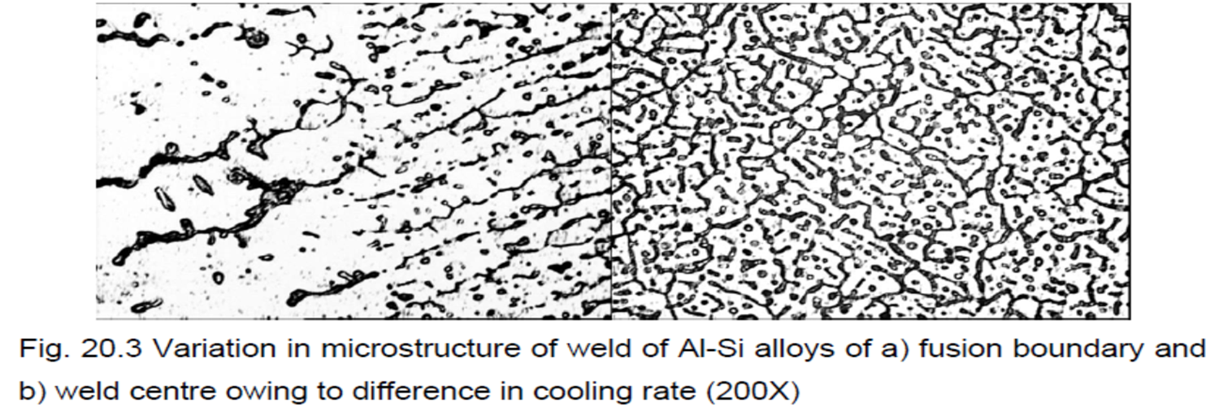
Solidification Rate
-An increase in net heat input (with increase in welding current / arc voltage or reduction in welding speed) increases the solidification time and allows each phase to grow to a large extent which in turn results in coarse-grained structure of weld metal which in turn adversely affects the mechanical properties .
Generally, centerline of the weld joint shows finer grain structure (Fig. 20.3) and better mechanical properties than those at fusion boundary primarily because of difference in solidification times. Micrographs indicate the coarser structure near the fusion boundary than the weld center.
-

Slide 13
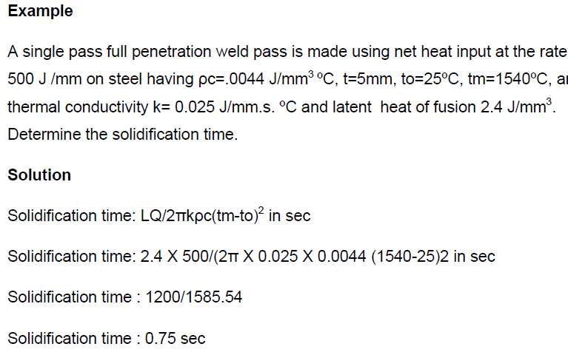
Solidification Rate

Slide 14
Residual Stresses- Definition
-Residual stress are locked-in stress present in the engineering components as a result of manufacturing processes such as heat treatment, machining, mechanical deformation, casting, welding, coating etc.
-It is due to non-uniform volumetric change in metallic component.
-However, maximum value of residual stresses doesn’t exceed the elastic limit of the metal because stresses higher than elastic limit leads to plastic deformation and thus residual stresses greater than elastic limit are accommodated in the form of distortion of components.

Slide 16
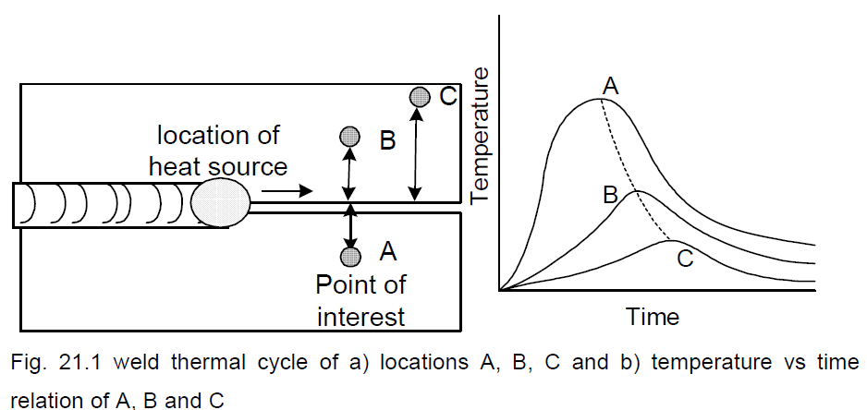
Residual Stresses in Welding
-Residual stresses in welded joints primarily develop due to differential weld thermal cycle experienced by the weld metal and HAZ during welding
-Type and magnitude of the residual stresses vary continuously during different stages of welding i.e. heating and cooling.

Slide 17
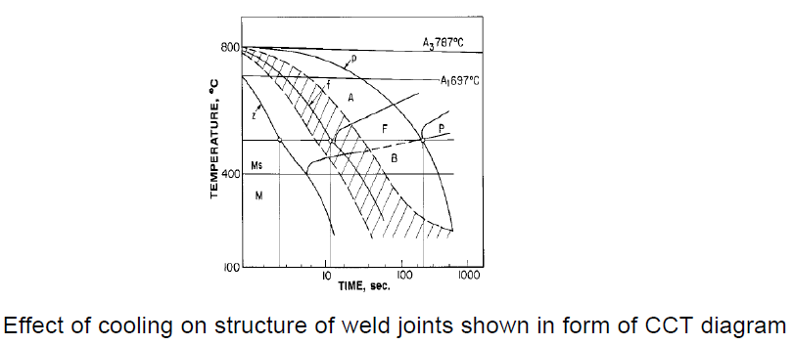
Cooling Rate
This is evident from the continuous cooling diagram of hypo-eutectoid steel as shown in Fig. 19.4. In the diagram, letter A, F, P, B, M indicates regions of austenite, ferrite, pearlite, bainite and martensit respectively.

Slide 18
Mechanisms of Residual Stress Development
-The differential volumetric change that that leads to residual stresses occurs both at macroscopic and microscopic level.
Macroscopic volumetric changes are caused by:
a) varying expansion and contraction and b)different cooling rate experienced by top and bottom surfaces of weld & HAZ.
-Microscopic volumetric changes mainly occur due to metallurgical transformation (austenite to martensitic transformation) during cooling.
-For example, hardening causes such transformation from austenite to martensite develops tensile residual stresses at the surface and compressive stress in the core.

Slide 19
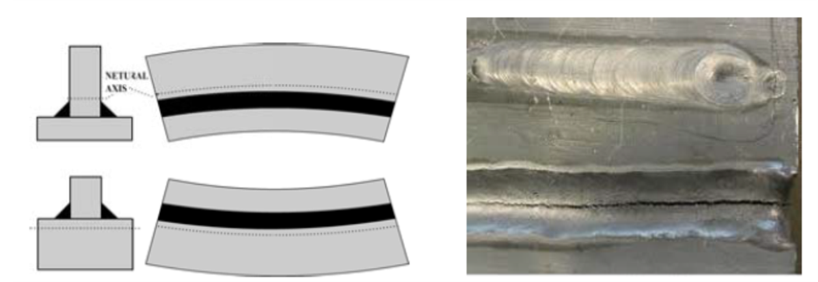
Effect of residual stresses
-Residual stresses can cause cracks distortion and reduction in mechanical performance of the weld joint.
- Conversely, compressive residual stresses decrease failure tendency under external tensile stresses.

Slide 20
